Slide 1
Team B: Jeffery Lietz, Bruce Eng, Tovia Bat-Leah, Dale Hendricks; CARs 153914933, 153915322, 153915273 + one “exemplary”.

Slide 2
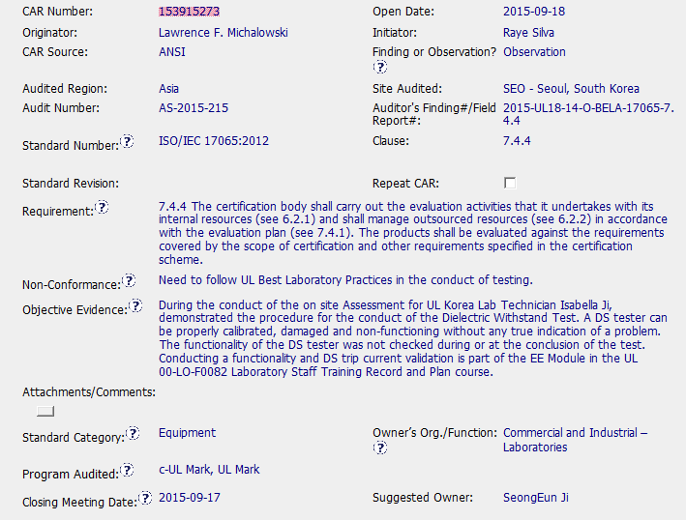
CAR 153915273 - Observation
Not clear which UL document is being referenced. (note ANSI CAR)
Could add OBS guidelines or links to aid CAR Owner.
Should be: Evaluation
Owner should be supervisor

Slide 3
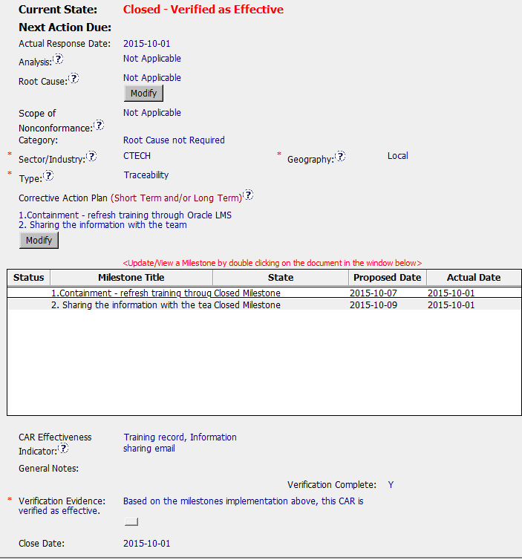
CAR 153915273 - Observation
Good CAP summary
Geography correct
Should be: Testing (Internal UL)
Milestones completed in timely manner
Appropriate Effectiveness Indicators
Verification Evidence meets requirements, but could use more detail.

Slide 4
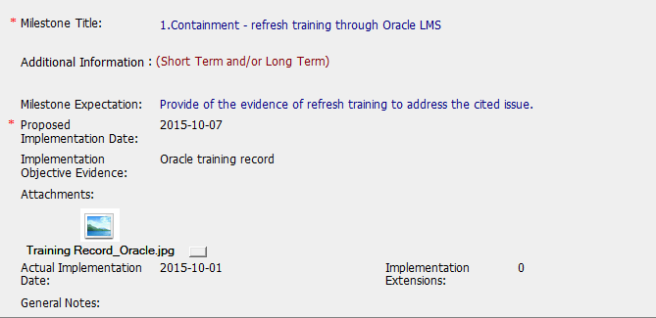
CAR 153915273 - Observation
Oracle LMS training record of Dielectric Withstand Test per Expectation and completed in a timely manner.

Slide 5
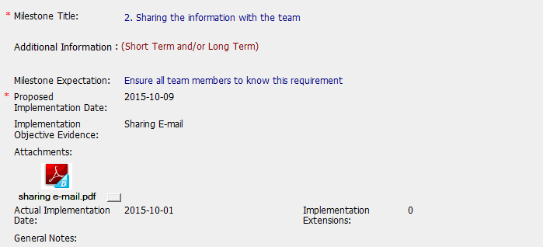
CAR 153915273 - Observation
Add more Milestone Expectation details such as: reply email or training sheet with signatures/date. To help guide the CAR Owner.
Very clear email to Seoul lab staff with steps and photos to communicate the requirement to perform the functional test.
No confirmation reply emails from the lab staff to confirm understanding.

Slide 6
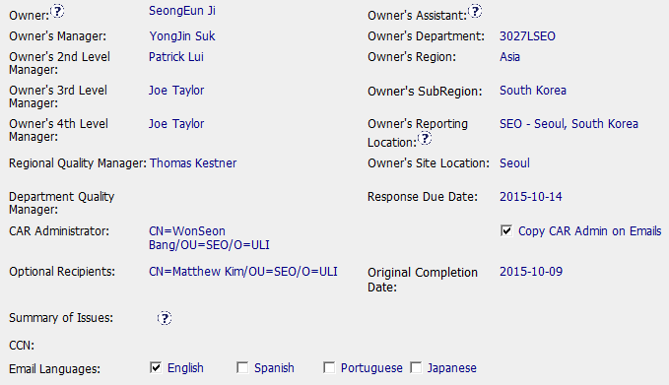
CAR 153915273 - Observation
Should be blank

Slide 7
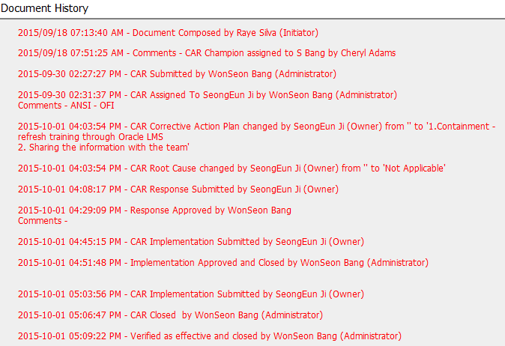
CAR 153915273 - Observation
Timely progression of this CAR.

Slide 8
CAR 153915273 - Observation
CBS Requirements | Excellent | Moderate | Need Improve | N/A
INTEGRITY
(C) Extensions are within requirement (<30 days, 3 or less) |  |  |  | x
(T) Most appropriate ‘category’, ‘type’, ‘geography’ are selected |  | x
(P) Facilitates the handling of disputed CARs |  |  |  | x
(T) Acts on CARs within required timeframe | x
COMPETITIVENESS
(C) Analysis shows clear path to root cause and scope; stakeholders identified |  |  |  | x
(C) Root cause statement is succinct, reasonable, complete (Shows ‘N/A’ for observations) | x
(C) Corrective actions fix the objective evidence and other problems found; address entire root cause and scope. For observations, they do not go beyond fixing the objective evidence |  | x
(C) Milestones expectations are clearly/completely set (milestone 2 expectation did not require evidence of reply email confirmations from the recipients). |  |  | x
(P) Verification per requirements | x
COLLABORATION
(L Referenced communications are attached as needed | x
(C L) Evidence of communication for overdue/escalated CARs and other pertinent concerns |  |  |  | x
(P) Trains other CAR Champions |  |  |  | x

